Slide 1

FINANCIAL SALES DASHBOARD
Task 4 – Dashboard Design using Power BI
Prepared By:
Kirpa Gupta
Tools Used:
Microsoft Power BI
Financial Sample Dataset

Slide 2

PROJECT OBJECTIVE
The objective of this project was to design an interactive Power BI dashboard that helps business stakeholders analyze financial sales data. The dashboard provides meaningful insights into sales performance, profit, products, customer segments, and geographical sales distribution through interactive visualizations and filters.

Slide 3
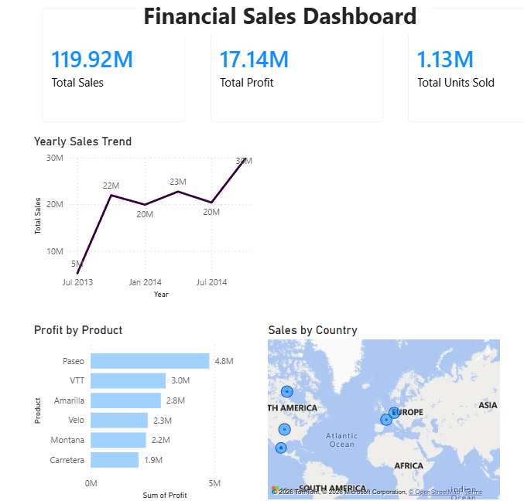
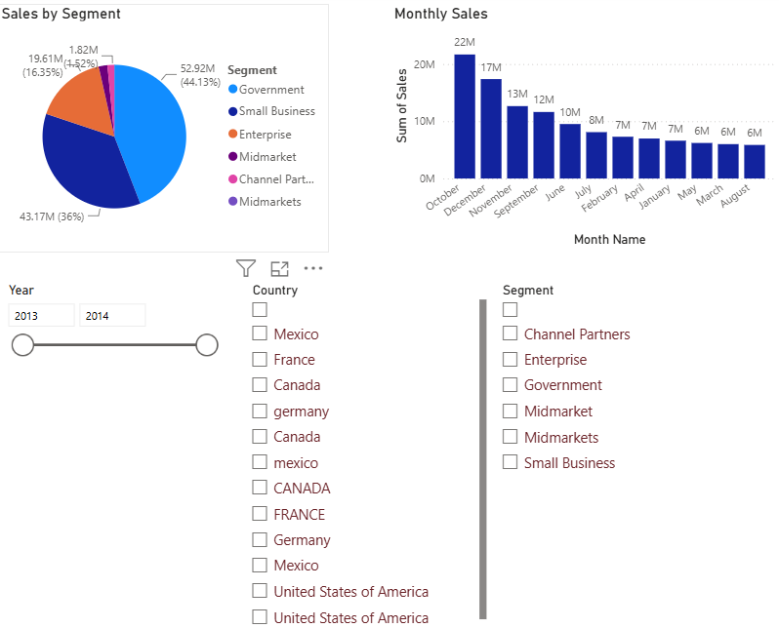
Interactive KPI CardsTotal Sales
Total Profit
Total Units Sold
Sales Trend Analysis
Profit by Product
Sales by Country (Map)
Sales by Segment
Monthly Sales Analysis
Interactive Filters (Year, Country, Segment)
DASHBOARD
FEATURES

Slide 4
KEY BUSINESS INSIGHTS
TOTAL SALES EXCEEDED 119 MILLION.
Total Profit exceeded 16 million.
Sales performance can be analyzed by year and quarter.
Product-wise profit comparison helps identify high-performing products.
Country-wise sales distribution highlights regional performance.
Customer segments contribute differently to total sales.
Interactive slicers enable dynamic data exploration.

Slide 5
TOOLS & SKILLS USED
Tools Used
Microsoft Power BI Desktop
CSV Dataset
Data Visualization
Dashboard Design
Skills Learned
Data Visualization
Business Intelligence
Dashboard Development
KPI Analysis
Interactive Reporting
Data Filtering using Slicers
Business Data Analysis

Slide 6
Conclusion
This project demonstrates how Power BI can transform raw financial data into meaningful business insights through interactive dashboards. The dashboard enables stakeholders to monitor key performance indicators, analyze sales trends, compare product performance, and make informed business decisions using interactive filters and visualizations.
Thank You!

